Slide 1
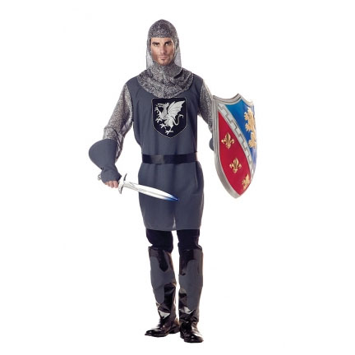
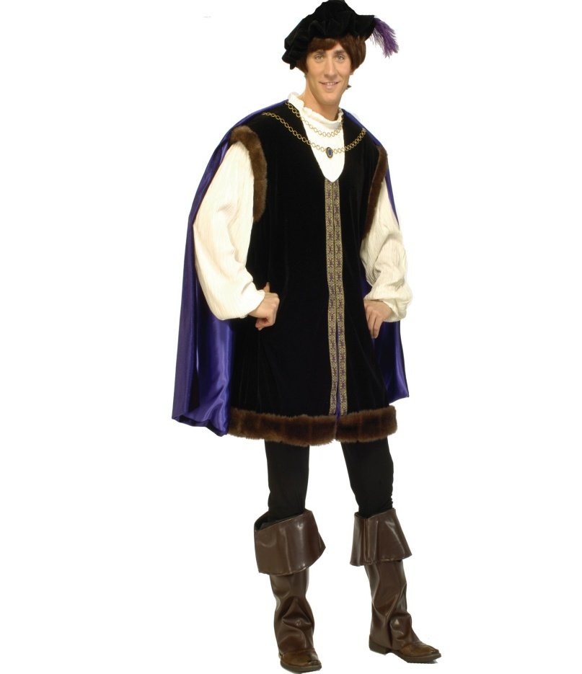
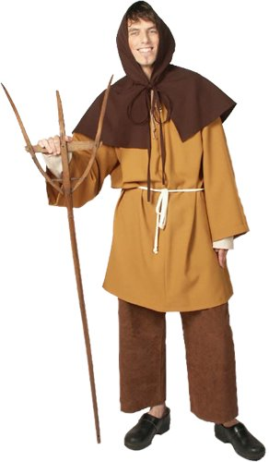
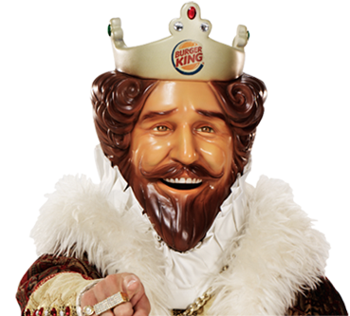
Gold Star = King/Queen
Silver Stars = Nobles
Red Stars = Knights
Green Stars = Peasants

Slide 2
The King/Queen
1. Who are you in charge of?
2. What are your responsibilities?
What are fiefs?

Slide 3
Nobles
1. Who are you in charge of?
2. What are your responsibilities?
Vassals

Slide 4
Knights
1. Who are you in charge of?
2. What are your responsibilities?
Why were knights always needed in the Middle Ages?

Slide 5
Peasants
1. Who is in charge of YOU?
2. What are your responsibilities?
Some peasants were considered ____________, because they were tied to the land they worked on.

Slide 6
The Feudal System
“I will do this for you, IF you do something for me.”
Everyone has a duty that helps out someone else in the feudal system. But, work is not free and people want something in return.

Slide 7
Pyramid of Power
King
Nobles
Knights
Peasants & Serfs

Slide 8
King
Noble
Knight
Noble
Knight
Peasants
Peasants
Manor #1
Manor #2

Slide 9
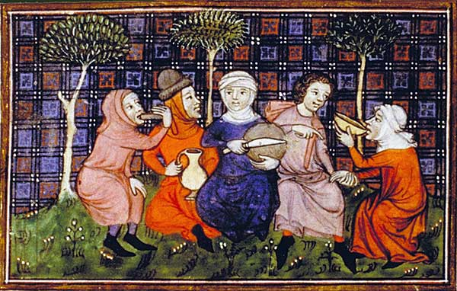
Each peasant must give his/her knight seven beans as payment for shelter and protection.

Slide 10
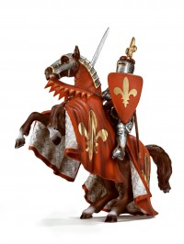
Each knight must keep ten beans
for himself/herself and give the
rest to the noble. The knights are
making this payment,
because they agreed to
serve and protect the
noble in exchange for
land.

Slide 11
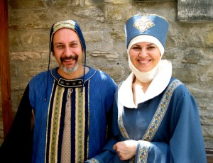
Each noble should keep twenty beans for himself/herself and give the rest to the king. The lord agrees to support the king on all matters in exchange for land and power.

Slide 12
The king collects the beans from both nobles as payment. Even though everyone had to “pay up,” they still ended up with some beans. This shows how feudalism was a give-and-take system.
Now, count your beans! How many beans to you have to give up as payment?

